Slide 1
TypeScript Middle
Bootcamp [TypeScript]
Dmitry Kiselyov

Slide 2
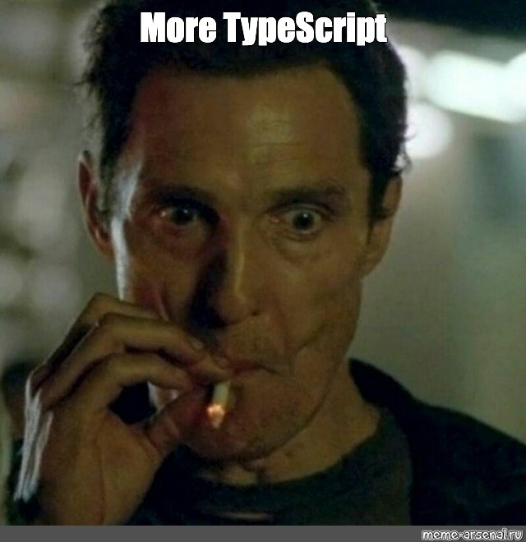
Bootcamp [TypeScript]

Slide 3
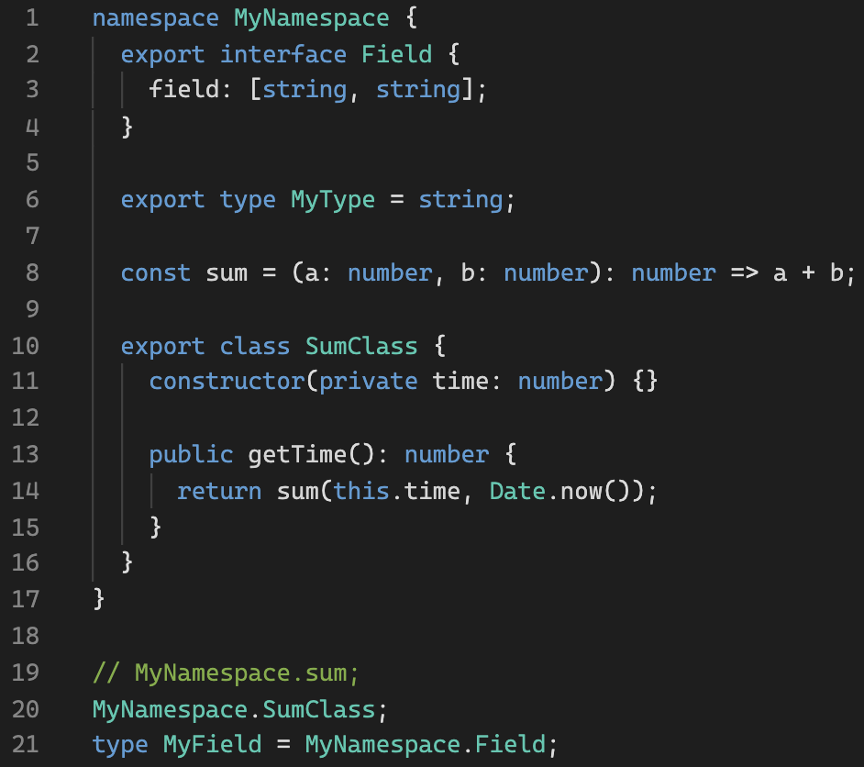
namespace
Playground link
Bootcamp [TypeScript]

Slide 4
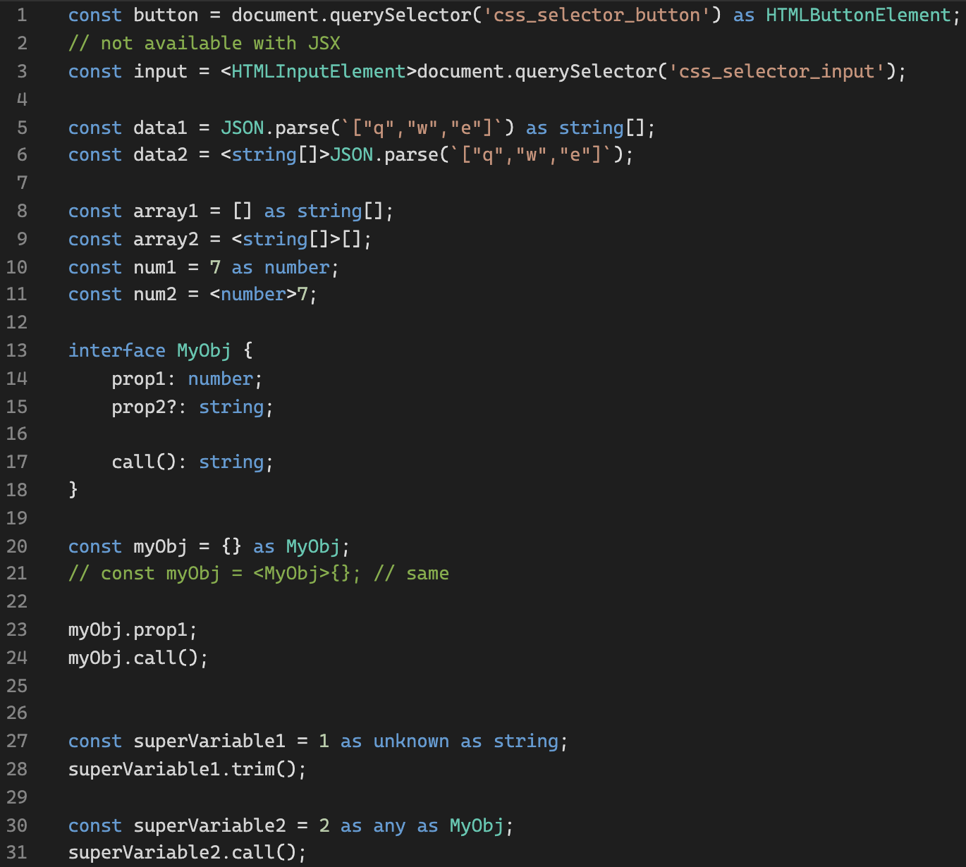
Type Assertions
Playground link
Bootcamp [TypeScript]

Slide 5
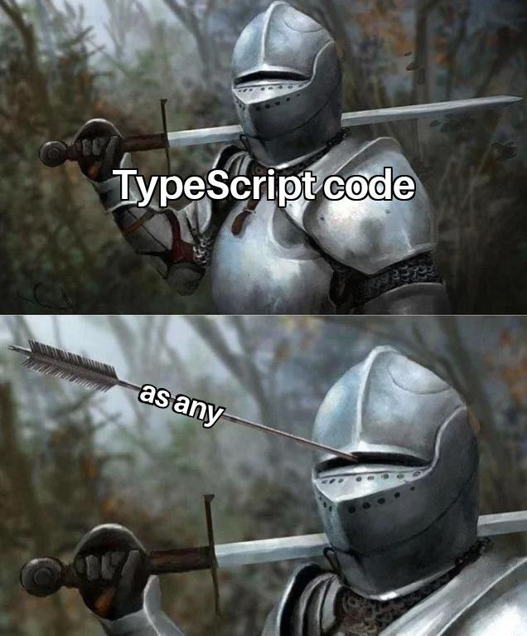
Type Assertions
Bootcamp [TypeScript]

Slide 6
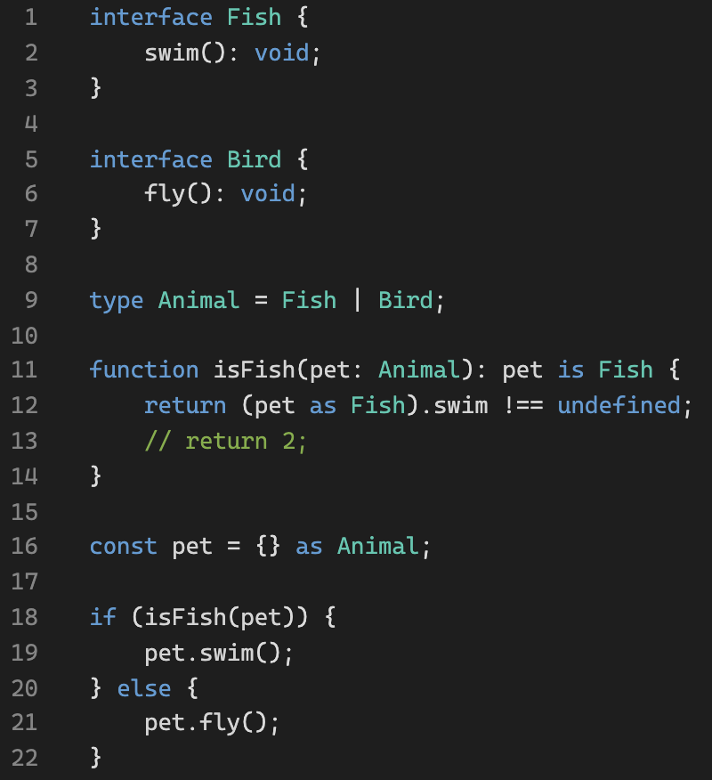
Type Predicates
Playground link
Bootcamp [TypeScript]

Slide 7
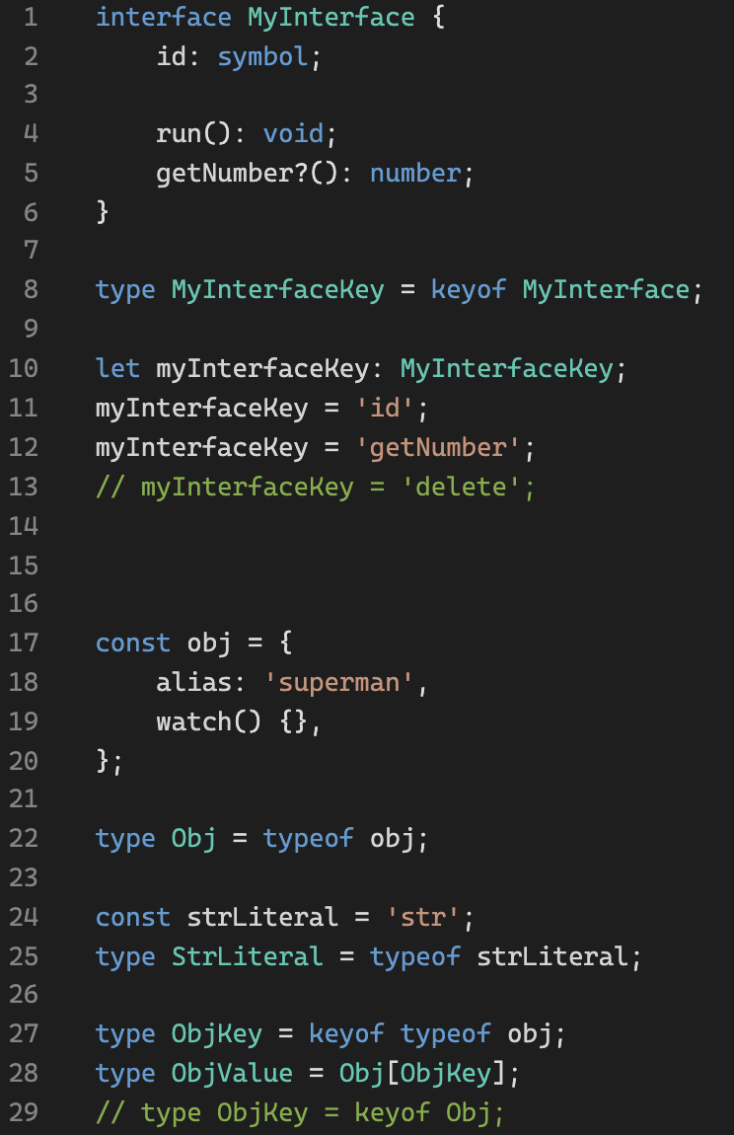
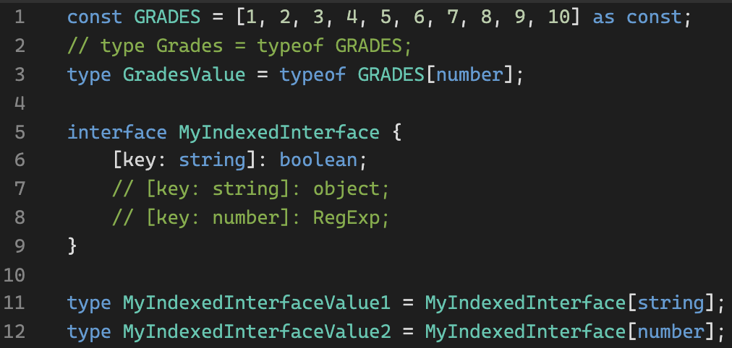
keyof / typeof
Playground link
Bootcamp [TypeScript]

Slide 8
Warm-up
Playground link
Bootcamp [TypeScript]

Slide 9
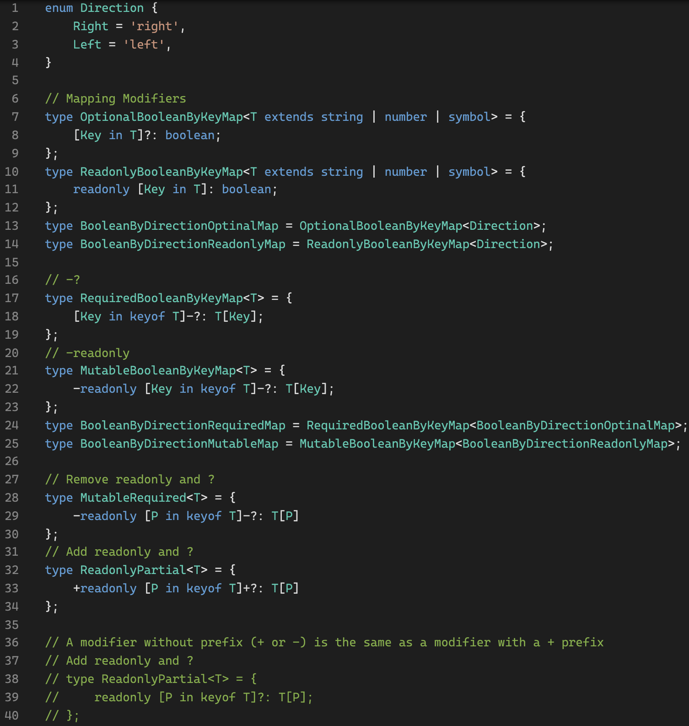
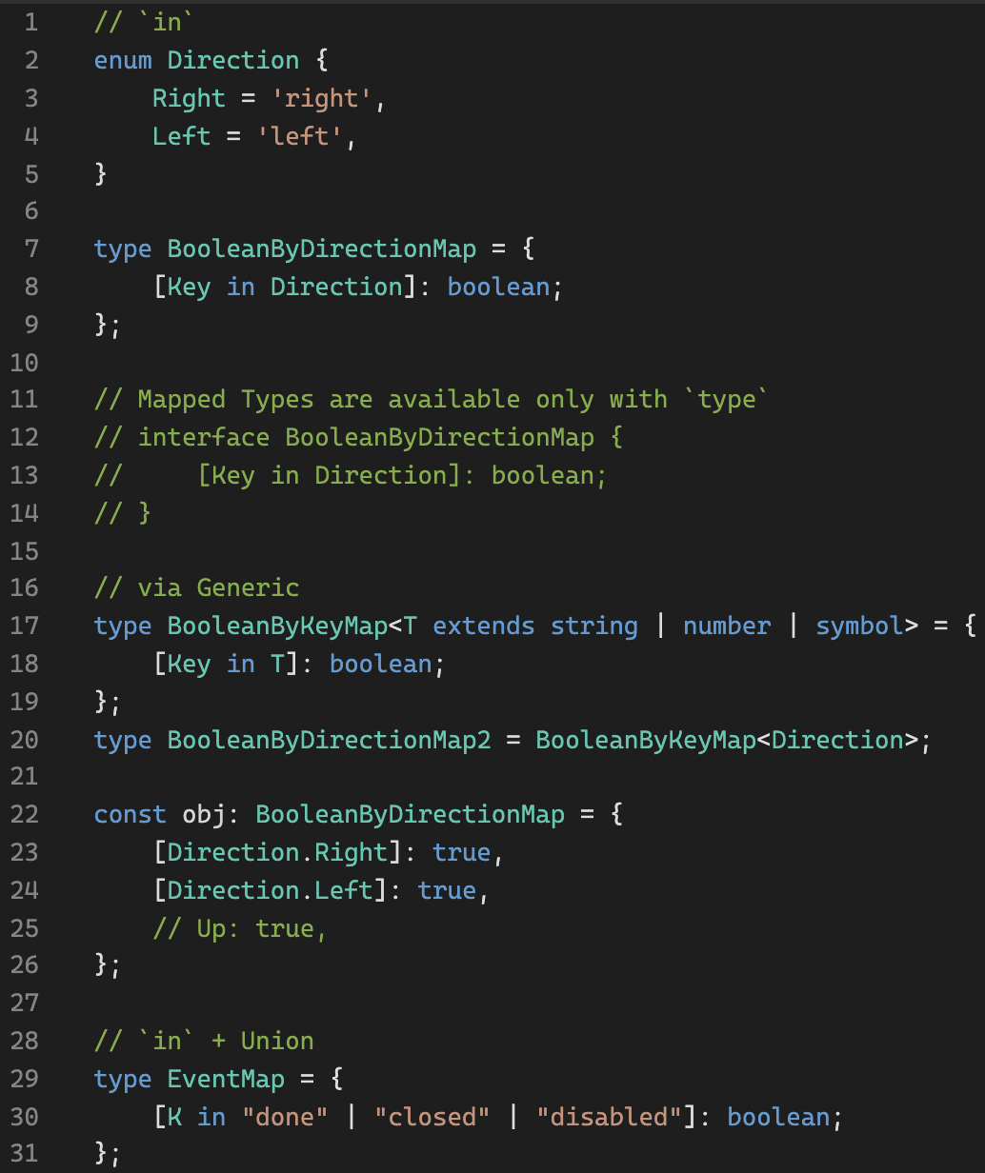
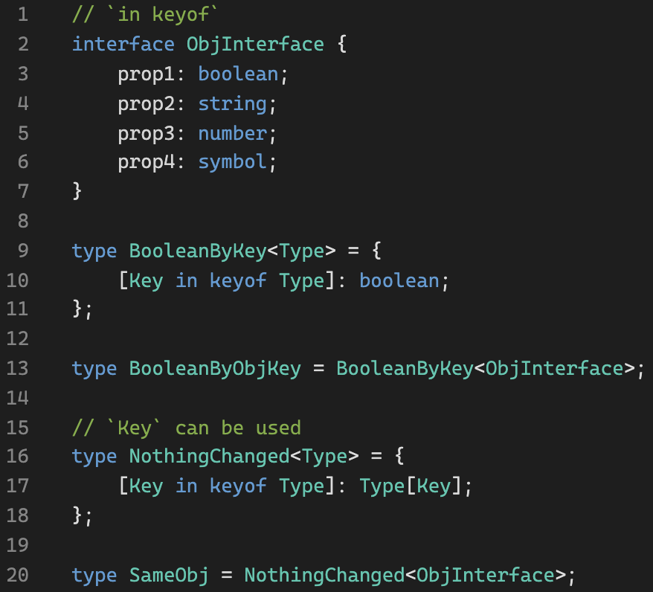
Mapped Types
Playground link
Bootcamp [TypeScript]

Slide 10
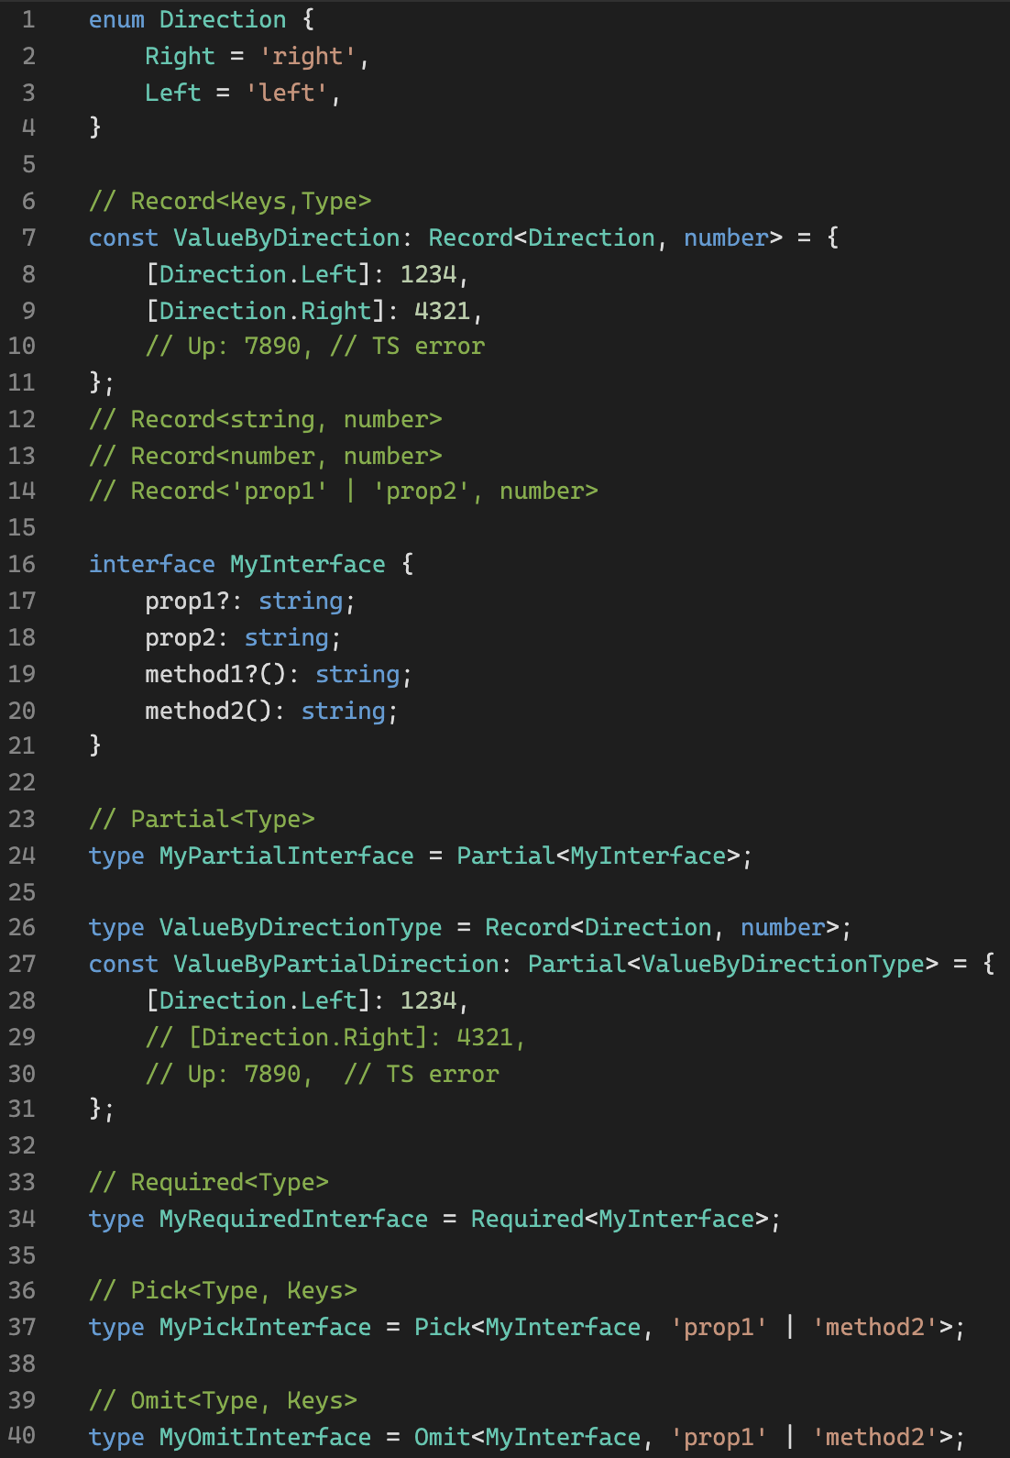
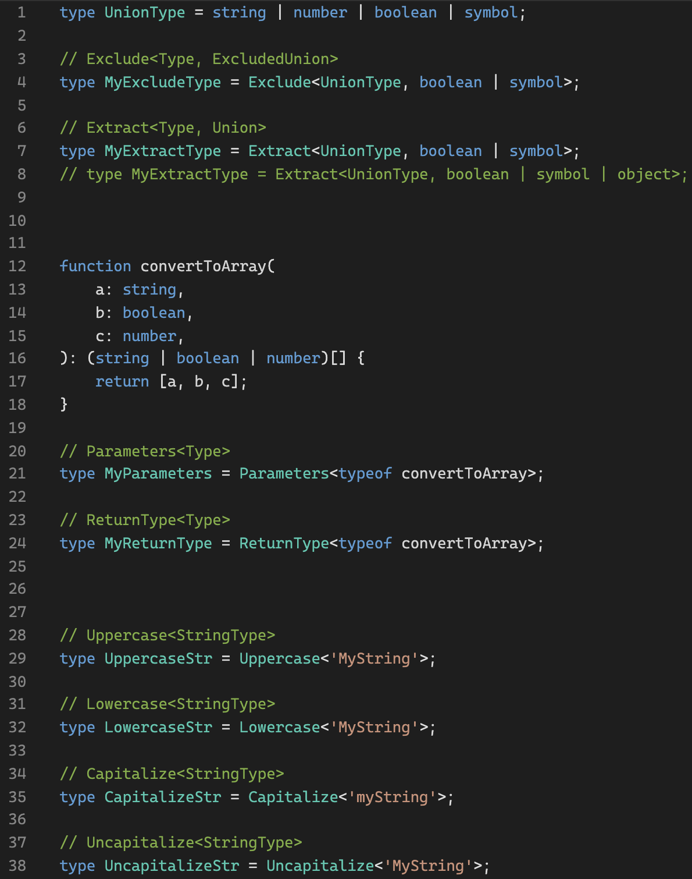
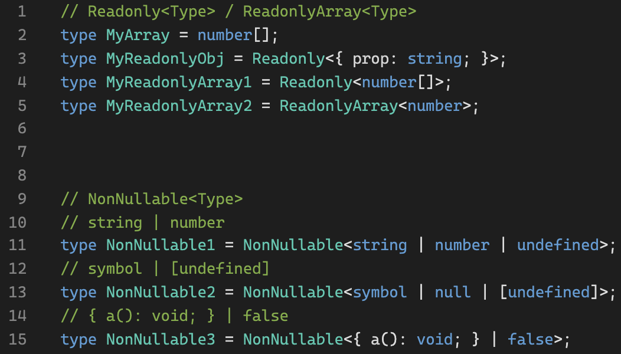
Utility Types
Playground link
Utility Types
Bootcamp [TypeScript]

Slide 11
Warm-up
Playground link
Bootcamp [TypeScript]

Slide 12
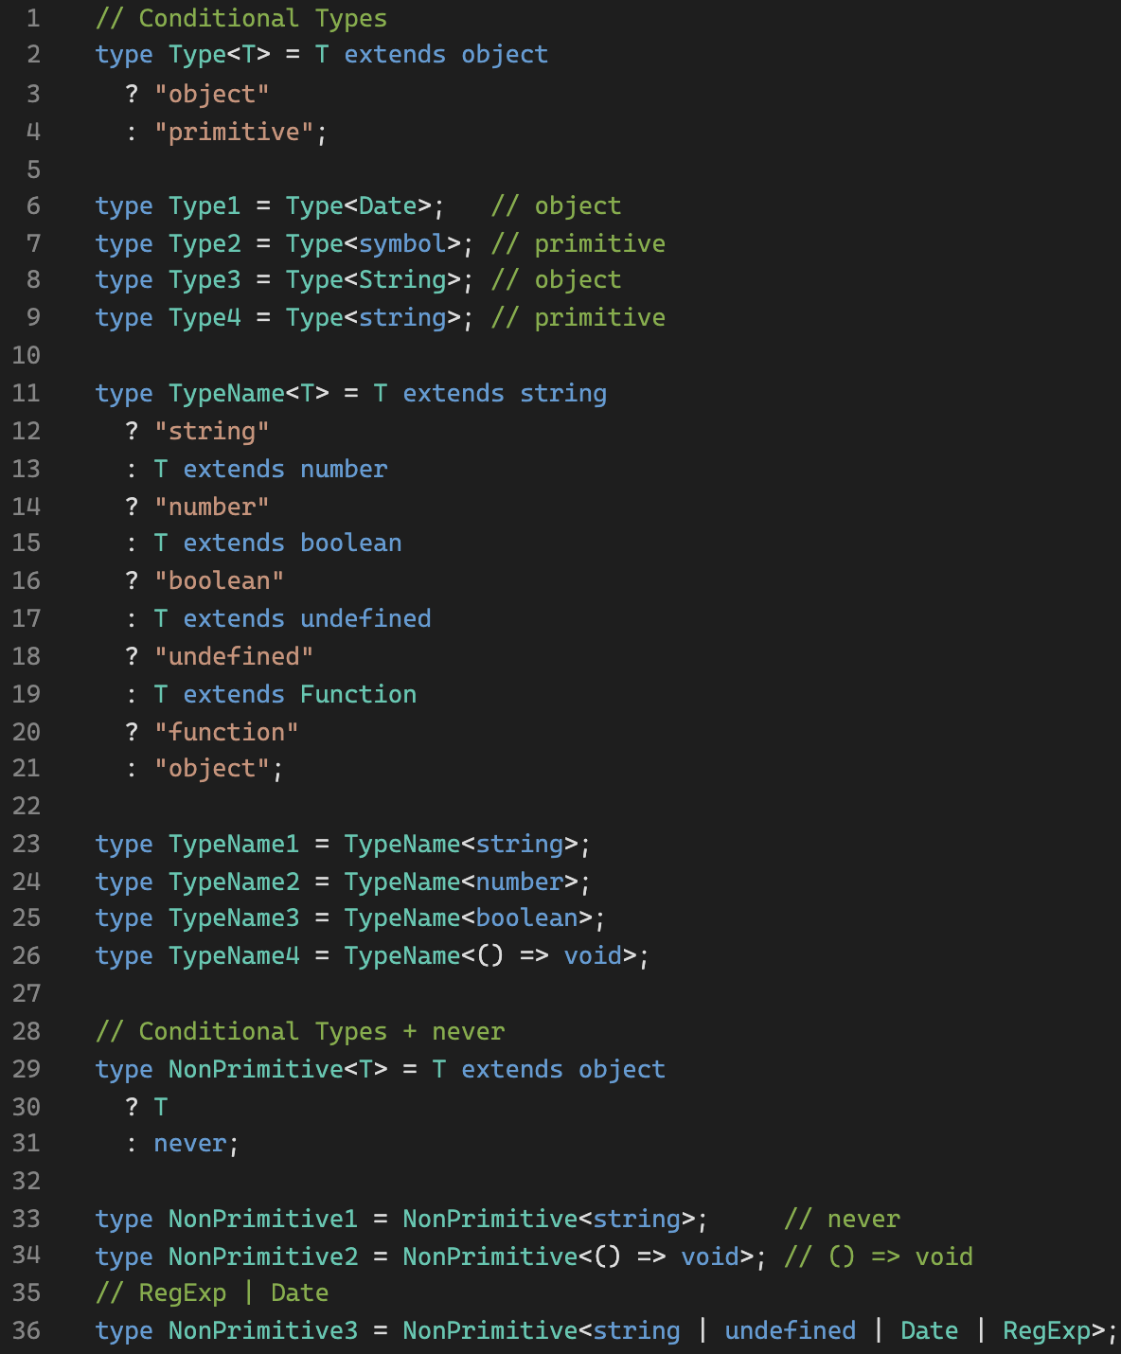
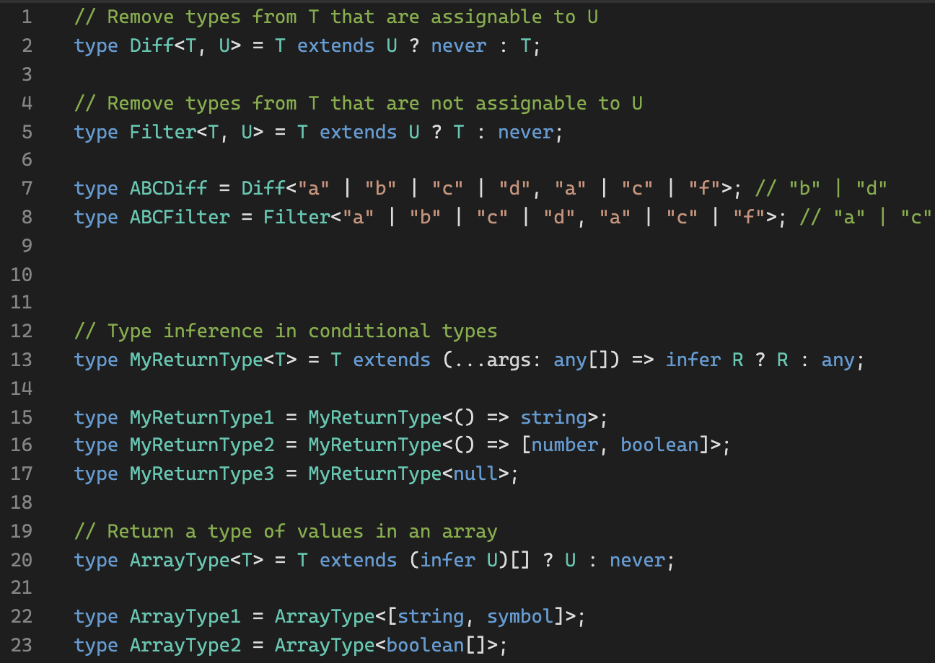
Conditional Types (never / infer)
Playground link
Power of `never`
Bootcamp [TypeScript]

Slide 13
Advanced Task (types)
During implementation try to implement several solutions:
Try to use Utility Types where suitable.
Try to implement without any Utility Types at all.
Tasks
Bootcamp [TypeScript]

Slide 14
Thank you!
Bootcamp [TypeScript]

